Slide 1
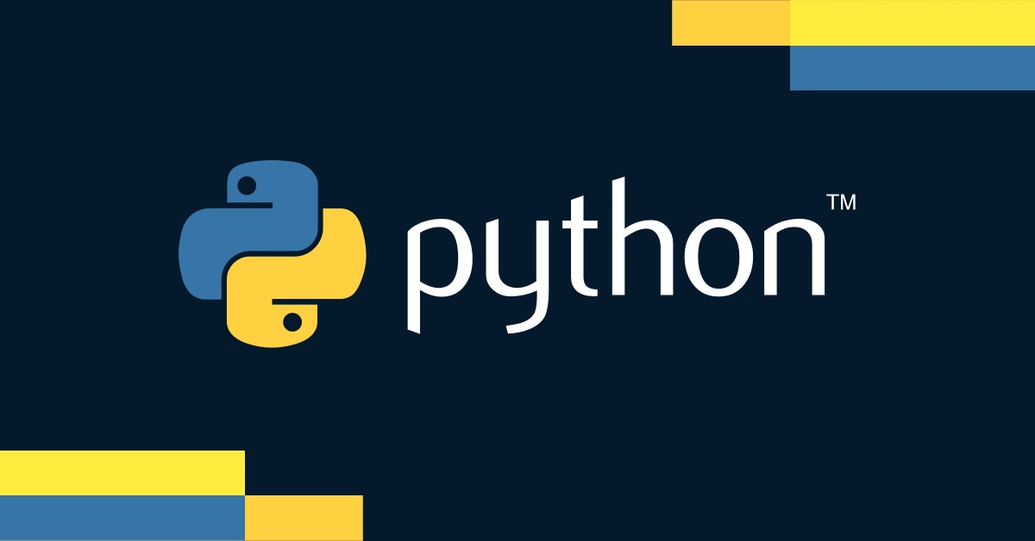

Slide 2
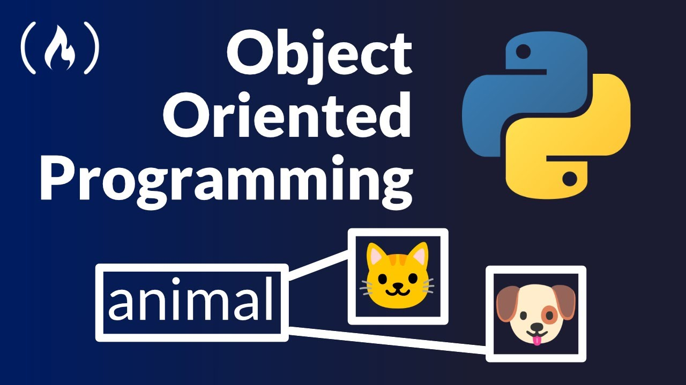

Slide 3
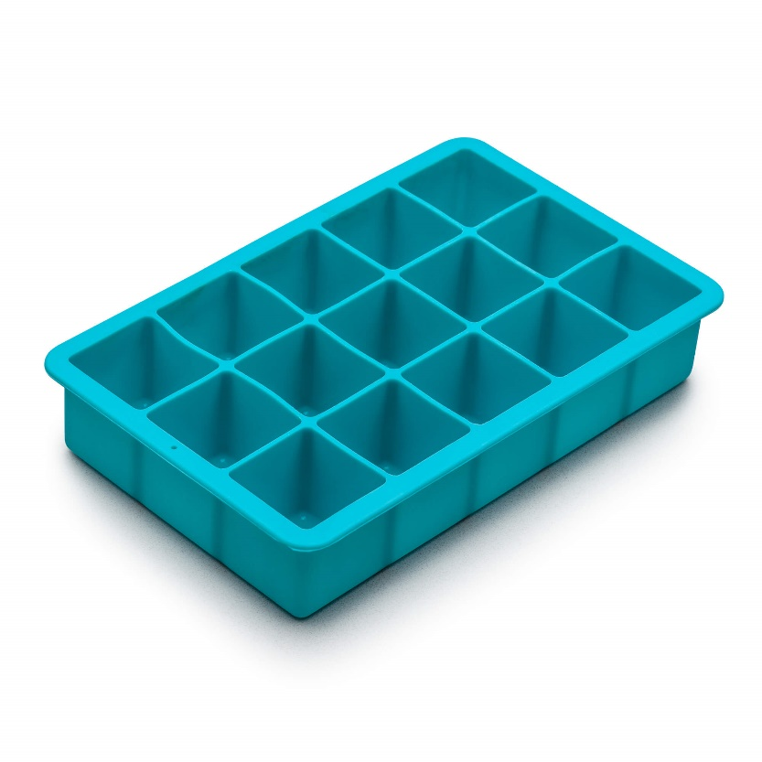




Slide 4







What is Object-Oriented Programming?
OOP is a programming paradigm based on the concept of "objects"
Objects are instances of classes, which are blueprints for creating objects

Slide 5



Why use OOP?
Modularity: Code is organized into classes, making it easier to manage.
Reusability: Classes can be reused across different programs
Scalability: Easier to add new features and maintain code

Slide 6

What is the concept of OOP?
What are the advantages of using OOP approach?

Slide 7


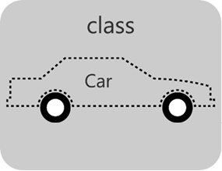


Classes and Objects
Class: A blueprint for creating objects (defines properties and behavior)
Object: An instance of a class (created from the blueprint)

Slide 8
Classes
Like blueprints or templates for creating objects
Define the attributes (properties) that objects of that class will have
Define the methods (functions) that objects of that class can perform

Slide 9
Objects
Objects are instances of a class
Created from a class blueprint
Each object has its own set of attribute values
All objects of the same class share the same methods

Slide 10

Give examples of OOP approach from daily life.

Slide 11
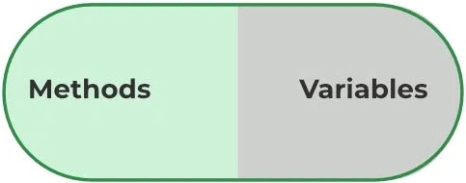
Objects contain
behaviour
data

Slide 12

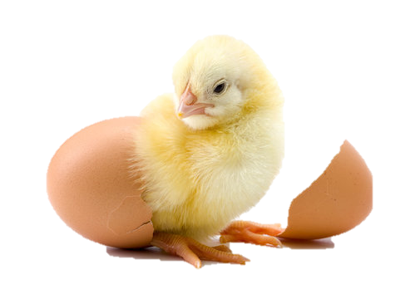
Creating a Class
Constructors (__init__ method):
Special method called when an object is instantiated
Initializes the object's attributes

Slide 13
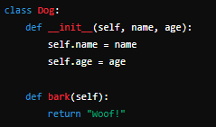

Methods
Functions defined within a class to perform actions

Slide 14
What is the difference between constructor and method?
Why constructor is required in instantiation?

Slide 15
Create a class of your own choice having constructor and method

Slide 16
HOME
Think of an app of your choice
Create at least 2 classes which belong to that app

